Slide 1
DOCTORIST
HealthAI - Yoddle use case

Slide 2
Introduction
Use case was to create Virtual Queue application for Walk-In clinics. Patient can get into queue for selected doctor and application will provide estimated waiting time. User can filter clinics by specialists and also check status of “waiting time”. When user clicks on clinic, application will display doctor names and address of clinic. User also will get text messages to the phone every 2 minutes with updated waiting time.

Slide 3
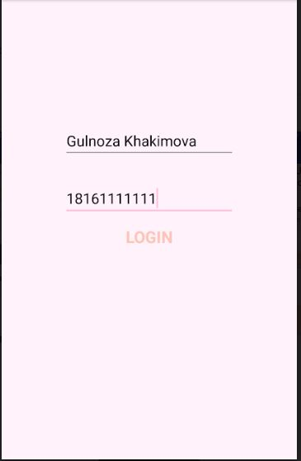
Login page
Name should be Full name
Phone number should start with “1”,
e.g. 18164421010

Slide 4
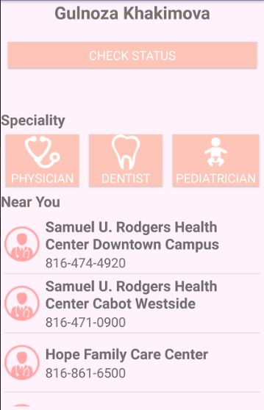
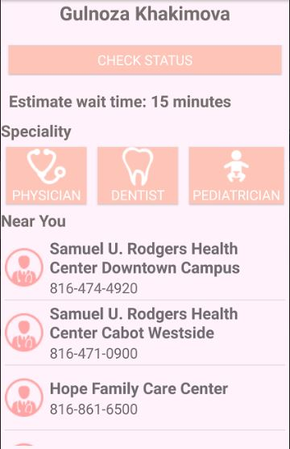
Main page
List of clinics are displayed on
main page, list can be filtered
by Specialist and User can
check Waiting Time status.

Slide 5
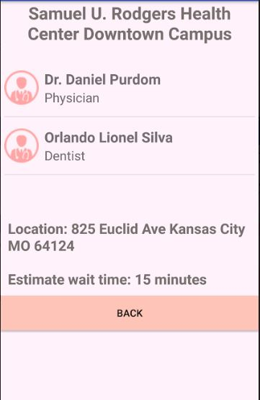
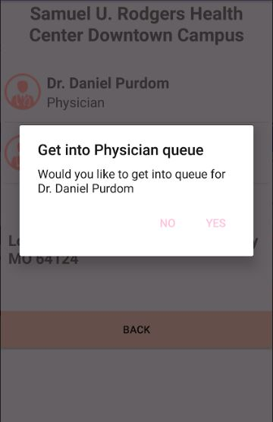
Clinic page
Displays list of specialist in
selected clinic and user can
get into queue by clicking
doctor’s name

Slide 6
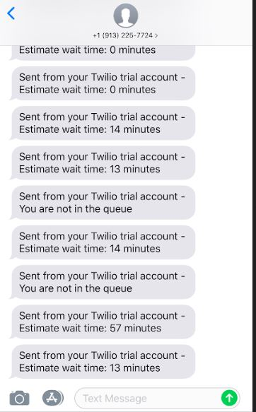
Messages
User gets message to indicated
phone number with updated
wait time.

Slide 7
THANK YOU

